Slide 1
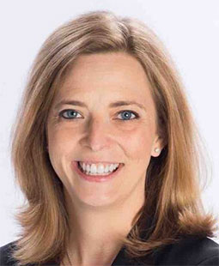
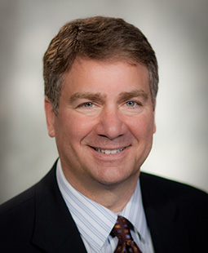
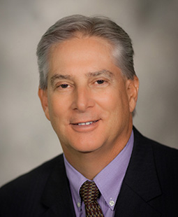
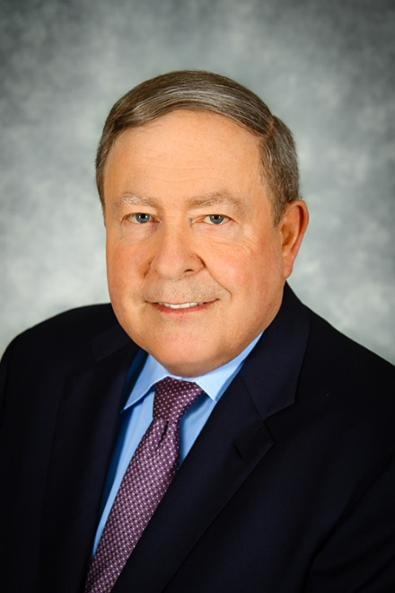
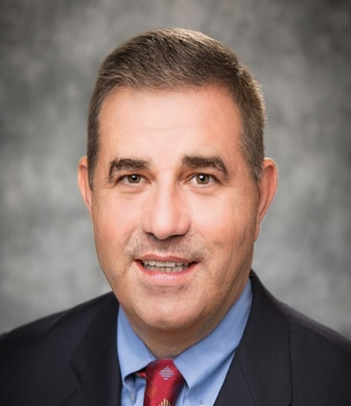
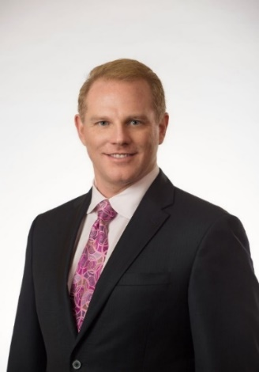
KNOW YOUR LEADERS
Ashley Glover
President
Mike Britti
GVP, M&A and Emerging Markets
Kurt Twining
Chief People Officer
Steve Winn
CEO
Barry Carter
Chief Information Officer
Tom Ernst
Chief Finance Officer

Slide 2
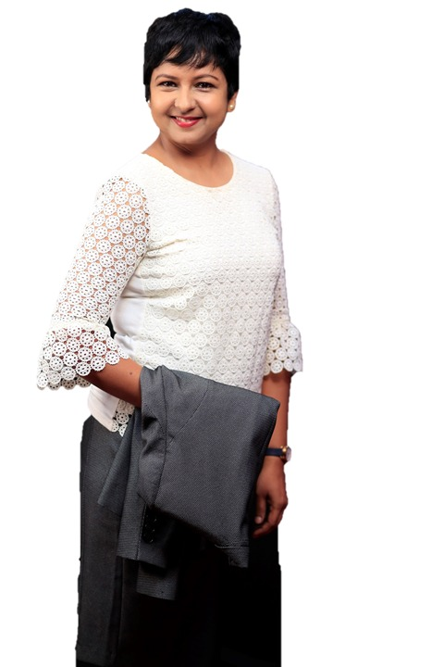
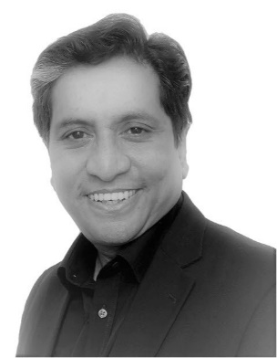
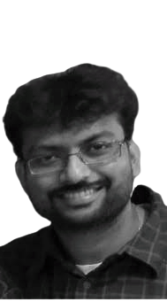
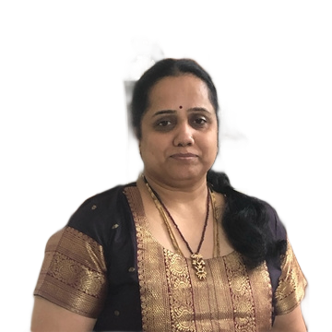
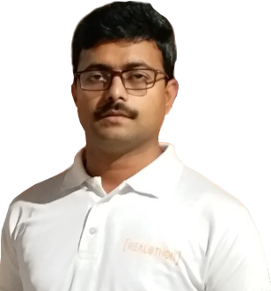
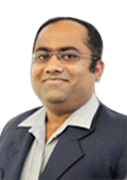
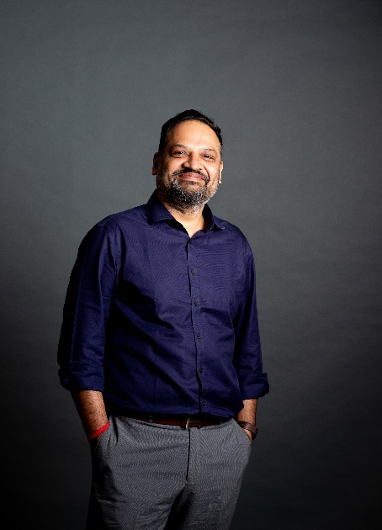
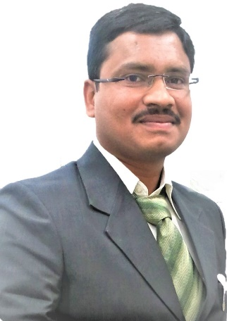
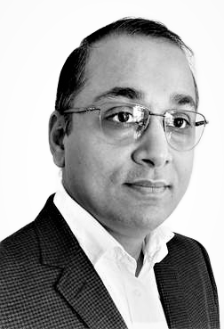
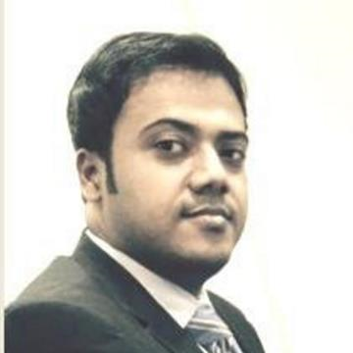
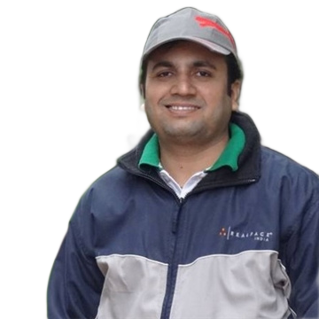
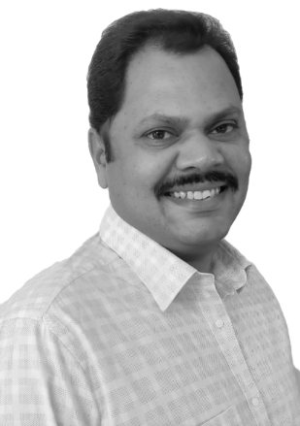
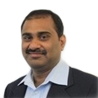
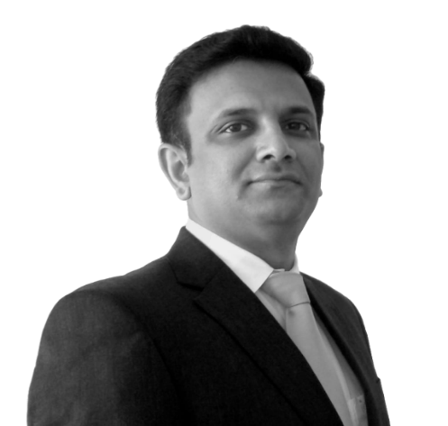
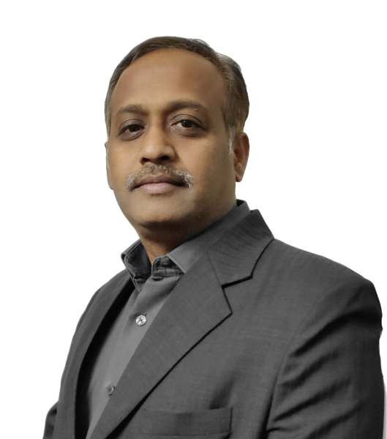
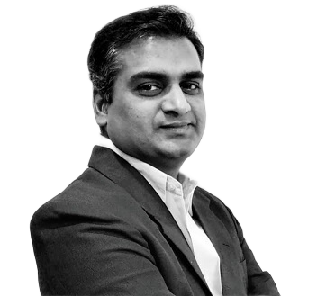
KNOW YOUR LEADERS–INDIA
ENGINEERING
Rekha Narendra
HR
Tanweer Jan & Sunil Billapati
US & India Finance
Nirmala Venkatesh
Consumer
Venkata Charan G
UPM
Prince Koshy
Property Management
Osman Akthar
Legal
Rohit Suchanti
BPM
Mrinal Sinha
Op Ex + Content Srvices
Sandeep Sharma
Country Head
Sandeep Raukutam
MDO
Suneel Nallu
Engineering
Virinchi Aknuri
Engineering
Sean Cardoz
REWS
Viswanath Tayi & Suresh Ikkurthi
IT & EIS

